Slide 1
RELAPSING FEVER
DAUDI E STEPHEN
EMMANUEL MBUKI
SUPERVISOR: PROFESSOR BAKARI

Slide 2
Outlines
Introduction
Epidemiology
Pathogenesis
Clinical presentation
Diagnosis
Treatment and prognosis
Prevention

Slide 3
Introduction
Relapsing fever (RF) is a vector-borne bacterial infection caused by spirochetes of the genus Borrelia, characterized by recurring febrile episodes separated by afebrile intervals that accompany spirochetemia
Febrile episodes of at least 38.5°C lasting 3–5 days each, with afebrile remissions of 4–7 days between episodes
World Health Organization. Relapsing Fevers: Key Facts. WHO Technical Report, 2021.

Slide 4
Introduction
The fever relapses result from spirochetal antigenic variation
If untreated may be fatal
Relapsing fever is an arthropod borne infection spread by lice( Pediculus humanus) and ticks (ornithodoros species)

Slide 5
Relapsing fever major forms
Relapsing fever Borrelia infections 3 major forms
  Soft tick relapsing fever ( STRF)
  Hard tick relapsing fever (HTRF)
  Louse borne relapsing fever (LBRF)
Relapsing Fevers: Key Facts. WHO Technical Report, 2021
Relapsing Fever. CDC Health Topics, 2023. https://www.cdc.gov/relapsing-fever
.

Slide 6
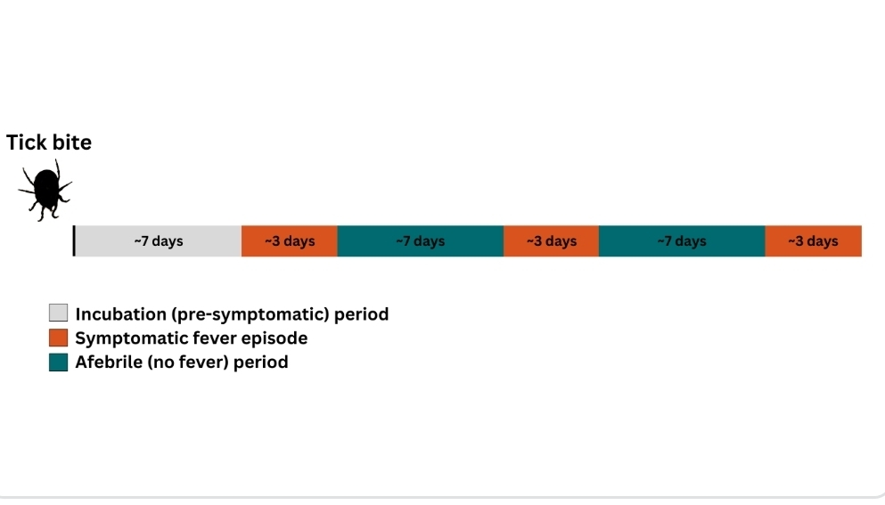
Pattern of Relapsing fever

Slide 7
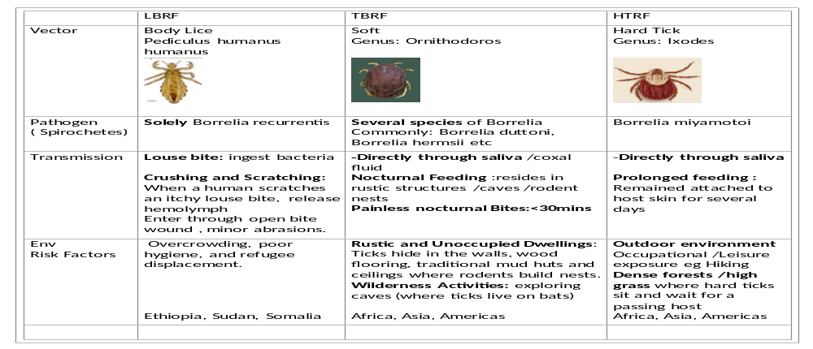
Epidemiological triad

Slide 8
Epidemiology
TBRF and LBRF vary significantly in terms of epidemiology
A soft bodied tick (ornithodos) transmits multiple Borrelia species that cause endemic relapsing fever (STRF)
A human body louse transmits B recurrentis which causes an epidemic form of relapsing fever (LBRF)
Humans are sole host of B recurrentis where mammals eg cattle, pigs, squirrels, chipmunks and reptiles serve as reservoir for tickborne Borrelia species

Slide 9
Epidemiology
Borrelia recurrentis, or epidemic relapsing fever or LBRF, is reported most commonly in areas of overcrowding and poor person hygiene
It causes epidermics and has previously associated with war, poverty and famines
STRF have been identified on all continent except Australia and Antarctica

Slide 10
Epidemiology
Ethiopia and part of Sudan are currently regarded as the only remaining countries where LBRF, remain endemic
STRF in East Africa usually caused by Borrelia Duttonii
West Africa usually caused by B crocdurae.

Slide 11
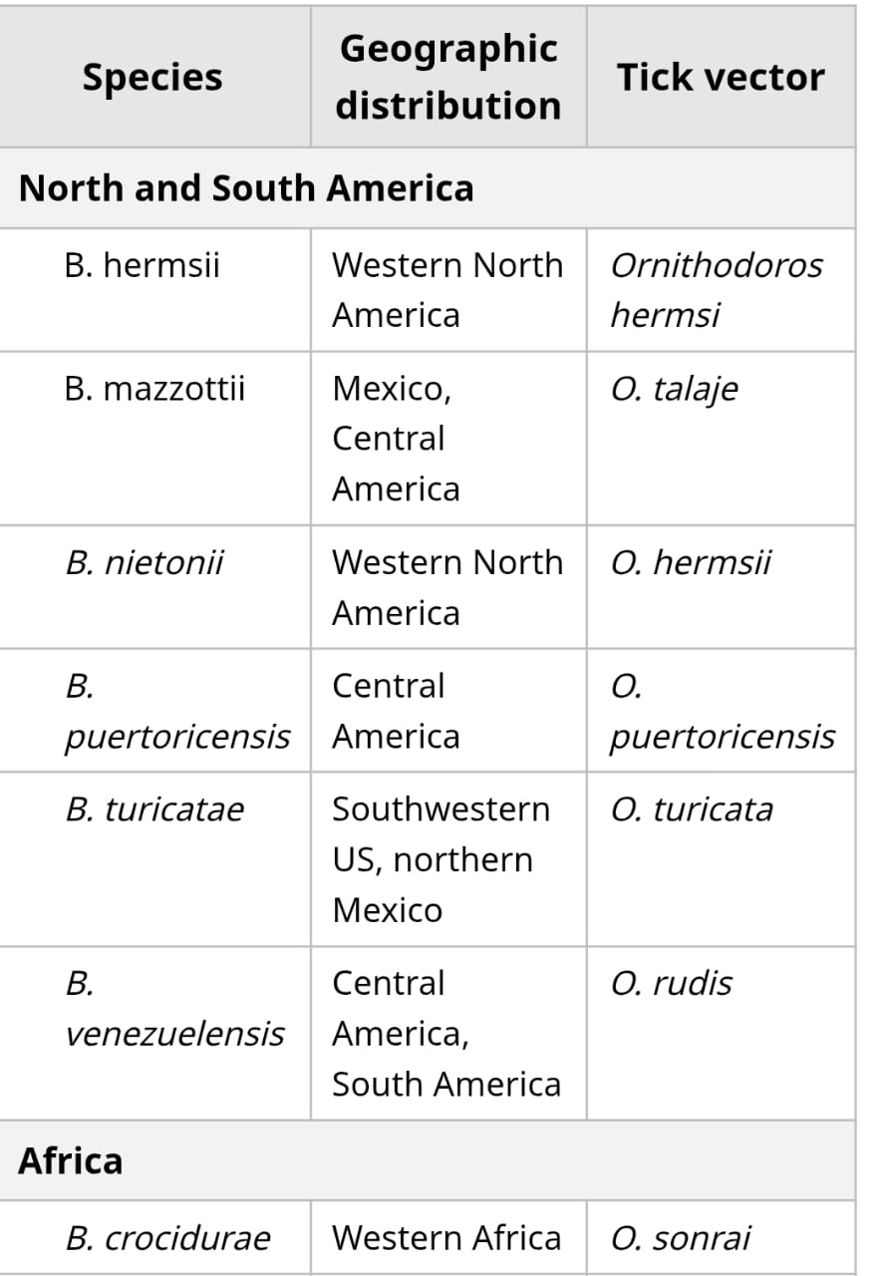
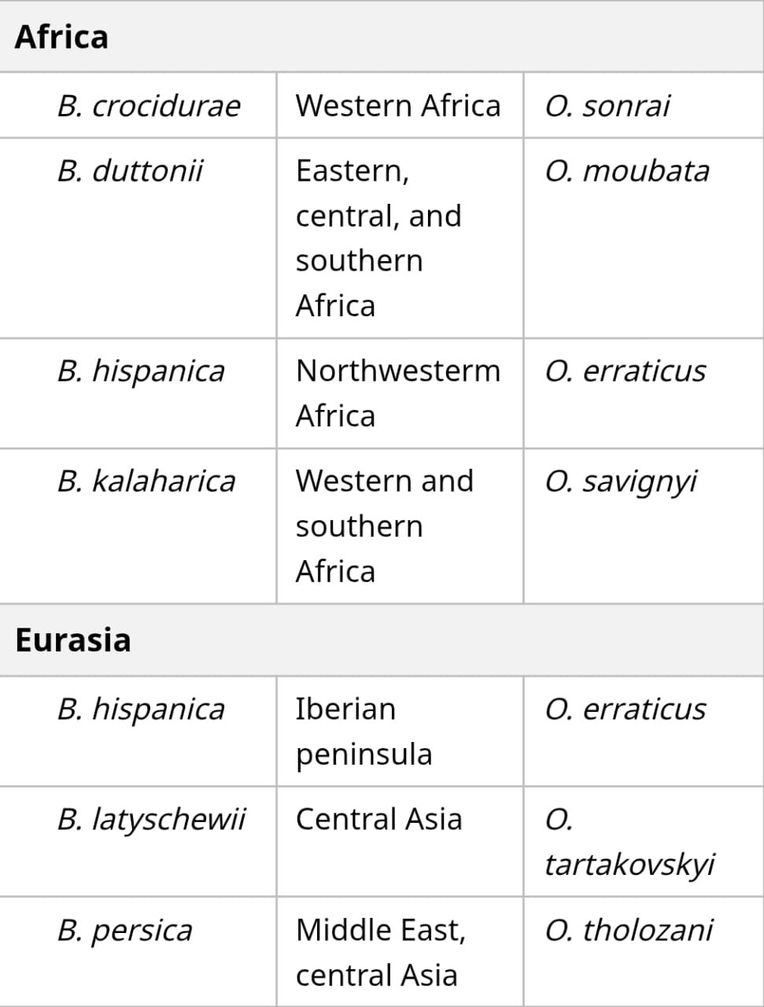
Borrelia species causing STRF

Slide 12
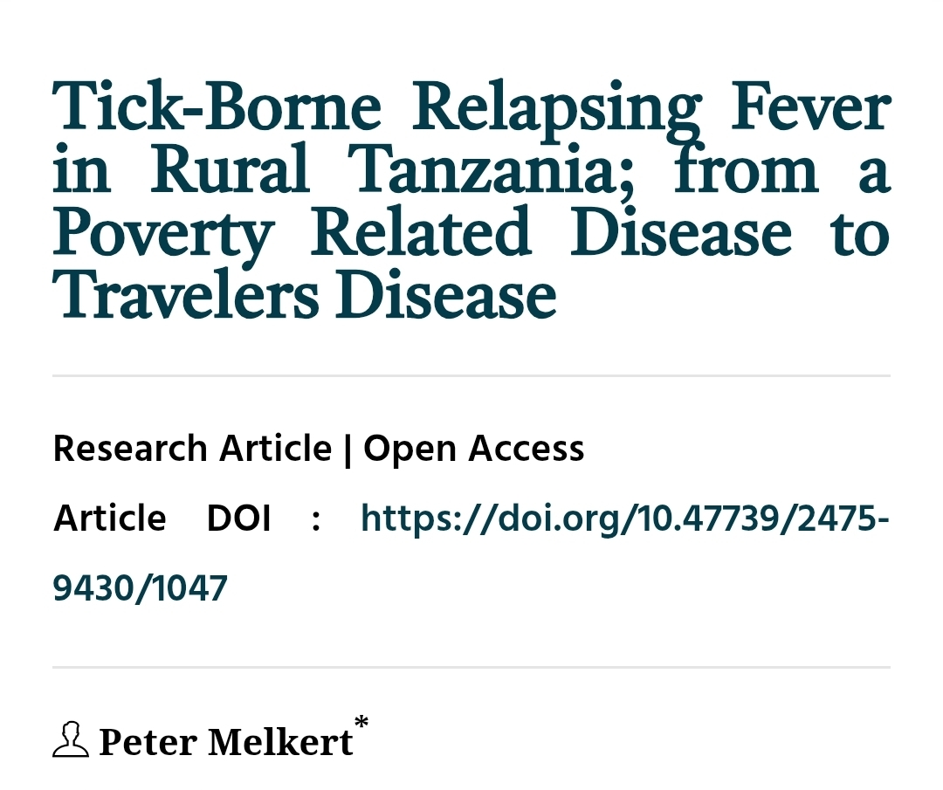
https://www.jscimedcentral.com/jounal-article-info/Annals-of-Clinical-Cytology-and-Pathology/Tick-Borne-Relapsing-Fever-in-Rural--

Slide 13
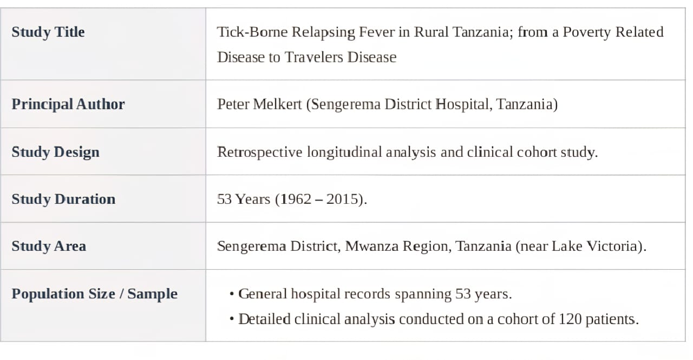
Epidemiology

Slide 14
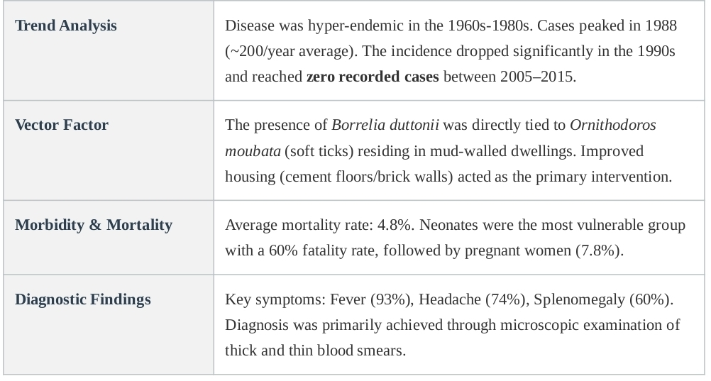
Epidemiology

Slide 15
Pathogenesis
Transmission and Entry
LBRF: Louse is crushed on skin; B. recurrentis enters through abrasions or mucous membranes (not by bite). Alternatively, contamination of conjunctiva
TBRF: Tick feeds for <30 minutes; spirochetes are injected with tick saliva. Ornithodoros ticks are painless feeders (nocturnal), making exposure often unrecognized

Slide 16
Pathogenesis
Spirochetemia and Immune Evasion
After inoculation, Borrelia disseminates hematogenously within 3–7 days
High-density spirochetemia (10^4–10^7 organisms/mL blood) drives febrile paroxysm via cytokine storm (IL-1, IL-6, TNF-α, IFN-γ)

Slide 17
Pathogenesis
Immune system mounts antibody response against expressed Vsp/Vlp antigens, clearing spirochetemia → clinical remission
A small subset of spirochetes switch to a new Vsp variant (segmental gene conversion), establishing new bacteremia → next febrile relapse
Cycle repeats 3–5 times in LBRF; up to 10+ times in TBRF

Slide 18
Pathogenesis
A single spirochete may be sufficient to initiate an infection.
RF is primarily an extracellular infection of the bloodstream.
In blood Borrelia divide every 6 to 12 hours→ 10⁶ to 10⁸ per mL of blood.
Spirochetes bind to to erythrocytes → aggregation of RBCs

Slide 19
Pathogenesis
Relapses are caused by antigenic variation of major antigen abundant on its surface.
Outer membrane lipoproteins called variable major proteins (VMPs)
They determine serotype identity of relapsing fever Borrelia spp
This places them one step ahead of the immune system

Slide 20
Pathogenesis
A single strain of a relapsing fever Borrelia species is able to produce several antigenically distinct variants called serotypes
These variable proteins also determine differences in disease expression.
  Example: the propensity for CNS invasion with B. turicatae
  (experimental studies with infected mice)
IgM specific for VMPs, appear after a few days of infection
  Direct bactericidal action or opsonization→ bacteria lysis occurs

Slide 21
Organ Involvement
CNS: Spirochetes cross blood-brain barrier; lymphocytic meningitis, cranial nerve palsies, cerebral hemorrhage
Liver: Hepatocellular damage from spirochetal invasion; periportal inflammation, Kupffer cell activation
Spleen: Splenomegaly from reticuloendothelial hyperplasia; splenic rupture (rare but life-threatening)

Slide 22
Organ Involvement
Heart: Myocarditis, conduction defects (QT prolongation, AV block)
Lungs: Acute respiratory distress from cytokine-mediated capillary leak
Placenta: Transplacental transmission → fetal spirochetemia → miscarriage, preterm labor, neonatal RF

Slide 23
Clinical presentation
Incubation Period
LBRF: 2–18 days (mean 7 days) after louse contact/infestation
TBRF: 4–18 days (mean 7 days) after tick bite

Slide 24
Febrile episodes pattern
Clinical Parameter | LBRF (B. recurrentis) | TBRF (Borrelia spp.)
Febrile episode duration | 3–6 days | 3–5 days
Afebrile interval | 5–9 days | 4–8 days
Number of relapses | 1–2 (usually) | 3–4 (can be >10)
Fever peak | 39–41°C | 39–41°C
Untreated CFR | 30–70% | 2–10%
JHR frequency | 55–90% | 30–60%

Slide 25
Clinical presentation
Constitutional Symptoms
Sudden-onset high fever with rigors (92–98%)
Profuse diaphoresis at defervescence
Severe headache (90–97%) – often retro-orbital
Myalgia and arthralgia (70–85%)
Fatigue, malaise, anorexia (>90%)

Slide 26
Clinical presentation
Neurological Manifestations (5–10%)
Meningism (neck stiffness, photophobia)
CSF pleocytosis (lymphocytic)
Cranial nerve palsies (VII most common, bilateral in TBRF)
Iridocyclitis, uveitis
Hemiplegia, aphasia (rare – due to CNS vasculitis)
Coma (severe/late disease)

Slide 27
Clinical presentation
Gastrointestinal
Nausea and vomiting (60–75%)
Abdominal pain, hepatomegaly (50–75%)
Jaundice (15–40% in LBRF; rare in TBRF)
Splenomegaly (up to 75%)

Slide 28
Clinical presentation
Cardiovascular
Relative bradycardia (unlike most febrile illnesses)
Myocarditis: chest pain, elevated troponin, ST changes
QT prolongation, first/second-degree AV block (ECG)
Hypotension (common during JHR)

Slide 29
Clinical presentation
Hemorrhagic Manifestations
Petechiae, epistaxis, conjunctival hemorrhage
Gastrointestinal bleeding (hematemesis, melena)
Subconjunctival hemorrhage (pathognomonic feature in some series)
Severe coagulopathy resembling DIC in fatal cases

Slide 30
Pregnancy-Associated
Pregnant women with relapsing fever tend to have a more severe and prolonged illness.
Transplacental transmission of the infection can occur leads to abortion or stillbirth;
Congenital malformations -not been reported.
A newborn may also be infected shortly after birth, and neonates with relapsing fever are at increased risk of complications.

Slide 31
Diagnostic approach
Diagnosis requires a high index of suspicion, Travel history, exposure to lice/ticks, and presence of relapsing fever pattern are key
Diagnosis is confirmed by detecting Borrelia in Giemsa-stained blood films, serological analysis or PCR detection of the organism

Slide 32
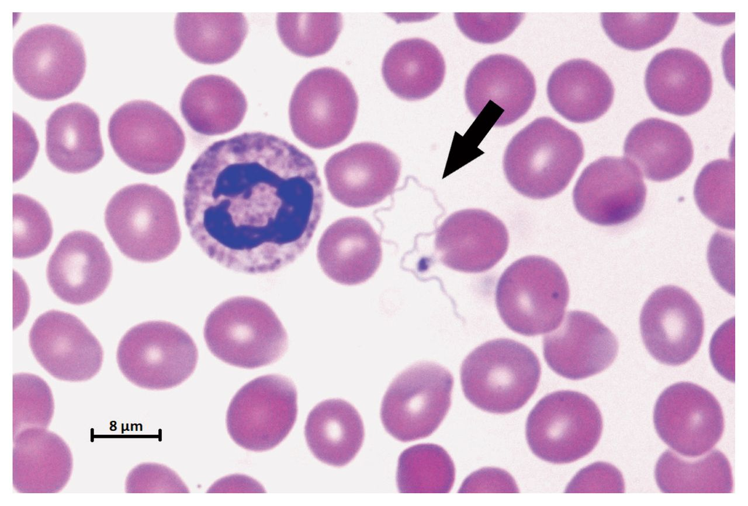
Diagnostic approach
Peripheral Blood Smear (Gold Standard)
Wright’s or Giemsa stain of thin or thick peripheral blood film during febrile phase
Sensitivity: 70–90% during acute spirochetemia
Dark-field microscopy enhances sensitivity
Note: Sample must be taken during febrile episode (spirochetemia absent in afebrile intervals)

Slide 33
Diagnostic approach
PCR (Polymerase Chain Reaction)
16S rRNA gene or flagellin gene (flaB) PCR from whole blood or CSF
Sensitivity: 94–100%, Specificity: 99–100%
Can speciate Borrelia
Useful in early infection before spirochetemia threshold reached

Slide 34
Diagnostic approach
Culture
Modified Kelly-Pettenkofer (MKP) medium or Barbour-Stoenner-Kelly (BSK) medium
Blood inoculation into culture medium; incubation at 32–34°C
Sensitivity low (~40–60%) due to fastidious growth requirements
Time-consuming (2–6 weeks); primarily for research/reference laboratories
Culture can be difficult to perform and is not routinely available.

Slide 35
Diagnostic approach
Serology
ELISA and Western blot for Borrelia-specific IgM/IgG
Sensitivity 50–70% (limited due to antigenic variation)
Useful for retrospective diagnosis or epidemiological studies
Not suitable for acute diagnosis in clinical settings

Slide 36
Other laboratory findings
CBC
A mild-to-moderate normocytic anemia is common,
Leukocyte counts normal range or slightly elevated; There can be leukopenia during the crisis
Thrombocytopenia.
ESR
ESR- elevated

Slide 37
Other laboratory findings
Liver function test.
elevated serum concentrations of unconjugated bilirubin and aminotransferases, Moderately prolonged PT, PTT
Hypoalbuminemia , is more often due to malnutrition than hepatic dysfunction

Slide 38
Other laboratory findings
CSF Analysis
(eg, when there are signs of meningitis or meningoencephalitis), the CSF examination usually reveals a mononuclear pleocytosis and/or mildly to moderately elevated protein levels with normal or elevated glucose concentrations

Slide 39
Imaging
Cardiovascular workup
In patients with myocarditis;
  ECG may reveal a prolonged QTc interval.
  CXR may show cardiomegaly and pulmonary edema

Slide 40
Differential diagnosis
Diagnosis | Distinguishing Features
Malaria | No true afebrile remission; P. falciparum continuous
Typhoid fever | Step-ladder fever, no relapsing pattern
Viral haemorrhagic fever | No relapsing pattern; high hemorrhagic risk
Louse-borne typhus | Eschar absent; maculopapular rash, delirium
Brucellosis | Undulating fever, insidious onset
Lyme disease | No relapsing fever; erythema migrans
Meningococcal sepsis | No relapsing; purpuric rash, rapid deterioration

Slide 41
LBRF– First-Line Treatment
Drug | Dose (Adult) | Route | Duration
Tetracycline (1st line) | 500 mg single dose | Oral/IV | Single dose
Doxycycline (1st line) | 100 mg single dose | Oral/IV | Single dose
Erythromycin (alternative) | 500 mg single dose | Oral/IV | Single dose
Penicillin G (pregnancy) | 300,000–600,000 IU | IV/IM | Single dose
Chloramphenicol (alt.) | 500 mg | Oral/IV | Single dose

Slide 42
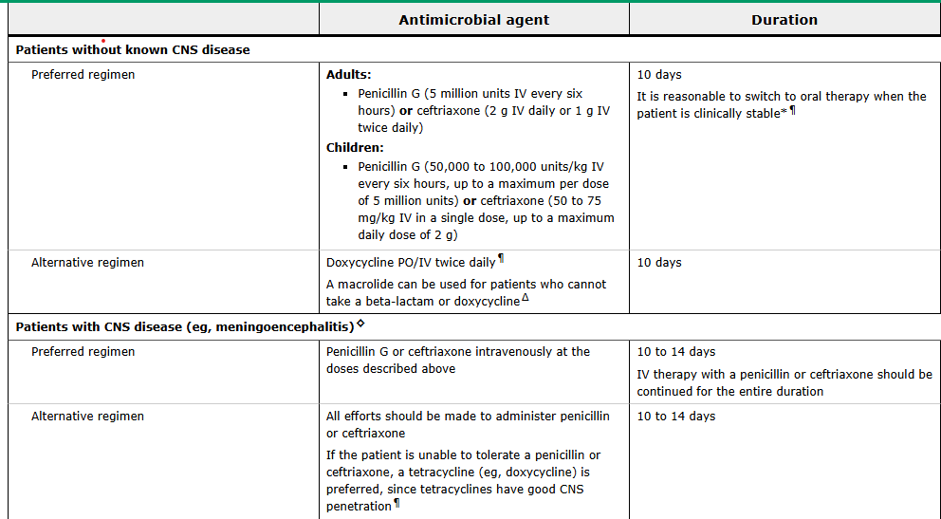
TBRF antimicrobial

Slide 43
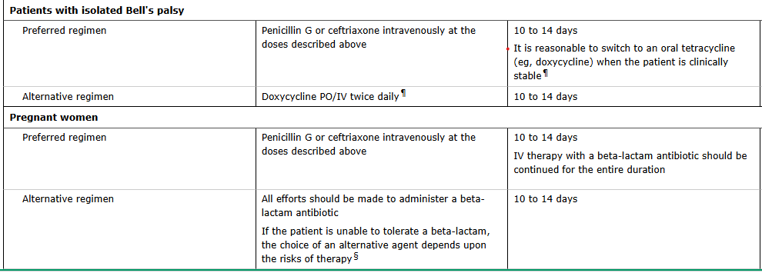
TBRF antimicrobial

Slide 44
STG - NEMLT 2021 FOR TBRF
Pharmacological Treatment -: erythromycin(PO) 500mg (or 12.5 mg/kg) 8 hourly for 14days
Tetracycline(PO)500mg 6hourly for 14days
Ceftriaxone (IV or IM) 2 grams daily for 10-14days is preferred for patients with central nervous system involvement

Slide 45
Jarisch-Herxheimer Reaction (JHR)
JHR is a systemic inflammatory response occurring 1–4 hours after the first dose of antibiotic
It results from massive release of cytokines (TNF-α, IL-6, IL-8) following rapid spirochete killing and antigen release
Frequency: 55–90% in LBRF; 30–60% in TBRF
Clinically: rigors, hyperthermia (temp spike 1–2°C above baseline), hypotension, and in severe cases, cardiorespiratory collapse
Notes:
. Mortality from JHR: up to 5% in LBRF. Anti-TNF strategies have been investigated but not routinely adopted (Reference: Warrell DA et al. Br Med J. 1983;307:1576–1580).

Slide 46
Management of Jarisch-Herxheimer Reaction (JHR)
JHR is not an indication to stop antibiotics
Premature cessation leads to treatment failure and higher mortality
Management is supportive

Slide 47
Management of Jarisch-Herxheimer Reaction (JHR)
Anticipate JHR within 1–4 hours of first antibiotic dose
IV fluid resuscitation for hypotension (normal saline 500 mL bolus, repeat as needed)
Supplemental oxygen for dyspnoea/desaturation
Antipyretics: Paracetamol 1 g IV/oral for fever spikes
Vasopressors (noradrenaline/dopamine) if refractory hypotension in ICU setting

Slide 48
Management of Jarisch-Herxheimer Reaction (JHR)
Newer treatment modalities-using of TNF-ANTAGONIST
  Eg: Infliximab and etanercept

Slide 49
Supportive Management
IV fluid resuscitation for dehydration and hypotension
Antipyretics (paracetamol preferred; avoid NSAIDs due to platelet dysfunction)
Blood transfusion for severe anaemia (Hb <7 g/dL)
Platelet transfusion if <10×10⁹/L or active bleeding
Fresh frozen plasma for DIC with coagulopathy

Slide 50
Supportive Management
Antiepileptics for seizures
Management of acute kidney injury
Nutritional support and management of hypoglycaemia

Slide 51
Pregnancy
Penicillin G (single dose IM) remains first-line to avoid tetracycline teratogenicity
Erythromycin 500 mg QDS for 7–14 days if penicillin allergic
Early treatment essential to prevent fetal loss and neonatal transmission
Neonatal relapsing fever: Penicillin G 50,000 IU/kg/day IV × 10 days

Slide 52
HIV Co-infection
Higher risk of treatment failure and atypical presentations
Prolonged antibiotic course (14 days) recommended
Monitor for opportunistic infections unmasked by immune reconstitution
No specific antiretroviral interactions with standard RF antibiotics

Slide 53
Prognosis
The mortality rates (TBRF) 4% to 10% and (LBRF) 10% to 70% with prompt antibiotic treatment, the mortality rate is reduced to less than 2% for TBRF and 2% - 5% for LBRF
Mortality secondary to relapsing fever has also been associated with Jarisch-Herxheimer reaction (JHR) for up to 5% in LBRF.
Stupor or coma, diffuse bleeding, Myocarditis, Malnutrition, poor hepatic function, Bronchopneumonia on admission denotes poor prognosis

Slide 54
Prevention and Control
Reducing exposure
TBRF; constructing houses with concrete or sealed plank floors and without thatched roofs or mud walls.
By using insect repellent containing DEET or permethrin to prevent tick bites
LBRF; improved personal hygiene, reduced crowding, and improved access to washing facilities

Slide 55
Prevention and Control
  There are no vaccines for either tick-borne relapsing fever (TBRF) or louse-borne relapsing fever (LBRF

Slide 56
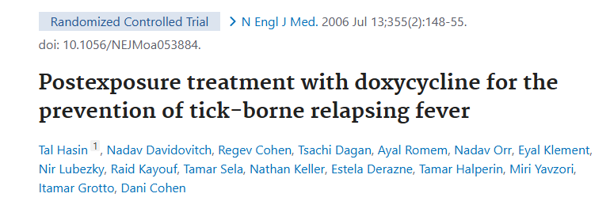
Tal hasin et al postexposure treatment wth doxycycline for the prevention of tick bone relapsing fever https://pubmed.ncbi.nlm.nih.gov/16837678/

Slide 57
Post exposure treatment
Double blind placebo controlled trial, 93 health subjects with suspected tick exposure
Received doxycycline 200mg/D1 then 100mg for 4 days
Result all 10 cases of TBRH identified by positive blood smear were in the placebo group
100% efficacy of preemptive treatment

Slide 58
Post exposure treatment
Oral doxycycline 200 mg 1st day then 100 mg daily for 4 days.
2nd line tetracycline 500 mg 6hourly for four days.
Erythromycin or another macrolide would be equally efficacious.

Slide 59
References
  World Health Organization. Relapsing Fevers: Key Facts. WHO Technical Report, 2021
  Relapsing Fever. CDC Health Topics, 2023 https://www.cdc.gov/relapsing-fever
  https://pubmed.ncbi.nlm.nih.gov/2096523/
  https://www.jscimedcentral.com/jounal-article-info/Annals-of-Clinical-Cytology-and-Pathology/Tick-Borne-Relapsing-Fever-in-Rural--
  https://www.ncbi.nlm.nih.gov/books/NBK441913/
  Uptodate clinical features, diagnosis and management of relapsing fever, microbiology, pathogenesis and epidemiology of relapsing fever

